Slide 1
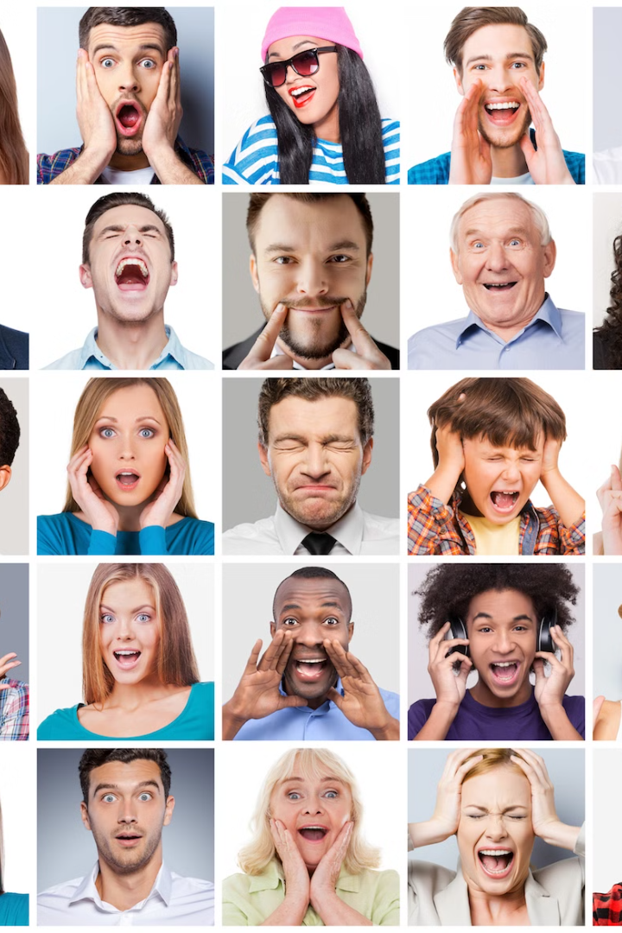
Face Emotion Recognition
Uncover the power of non-verbal communication through computer-based emotion recognition.
by kirti vardhan singh(210301120137)
Ayushi Priyadarsani(210301120206)
Debasis Mohanty(210301120003)
Sanjeev Kumar(210301120184)

Slide 2
AGENDA
Introduction
Result and Discussion
Proposed work
Application
Block Diagram
Future Trends

Slide 3
Introduction
Project Aim
Importance
Facial Recognition Process
Develop a model for facial emotion recognition using computer vision and machine learning techniques
various applications:
Human-computer interaction
Mental health monitoring
Market research
Analyze facial emotions like happiness, sadness, anger, or surprise.
Benefits
Model Training:
Deployment
Enhance communication and understanding between humans and machines.
Train a deep learning model, likely a convolutional neural network (CNN),to Recognize and classify emotions accurately
Enable real-time emotion detection from images or video streams

Slide 4
Data Gathering and Augmentation
Dataset
Image Download
Data Augmentation
Publicly available facial emotion recognition dataset
Dataset accessible through Kaggle
Expanded dataset through techniques like rotation, Rescaling, zoom, flip

Slide 5
Model Building
CNN Layers
Max Pooling
Flatten
Dropout
Convolutional layers to extract visual features
Downsampling to reduce spatial dimensions
Convert 2D feature maps to 1D vector
Reduce overfitting by randomly dropping neurons

Slide 6

Training
1
Leveraged Variants of Model Layers
2
Optimized Hyperparameters
3
Achieved 40% Validation Accuracy
Tried different combinations of CNN, pooling, and dropout layers
Tuned learning rate, batch size, and other training parameters
The best model performed exceptionally well on the validation set

Slide 7
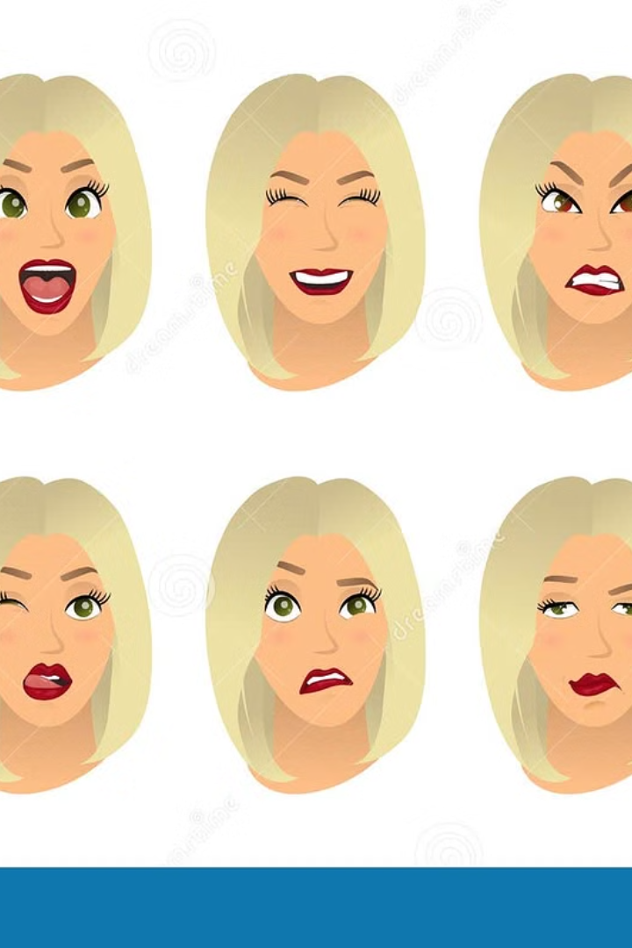
Testing
The model was tested with sample images, detecting 7 types of emotions: Angry, Sad, Neutral, Disgust, Surprise, Fear, and Happy.

Slide 8
Proposed Method
Face Emotion Recognition
Humans are used to non verbal communication. The emotions expressed increases the clarity of any thoughts and ideas. It becoms quite interesting when a computer can capture this complex feature of humans, ie emotions. This topic talks about building a model which can detect an emotion from an image. There key points to be followed are:
Data gathering and augmentation
The dataset is taken from Kaggle. It can be downloaded through the link "https://www.kaggle.com/datasets/jonathanoheix/face-expression-recognition-dataset".
Model building
The model architecture consists of CNN Layer, Max Pooling, Flatten and Dropout Layers.
Training
The model was trained by using variants of above layers mentioned in model building and by varying hyperparameters. The best model was able to achieve 40% of accuracy.
Testing
The model was tested with sample images. It can be seen below:
The model will be able to detect 7 types of emotions:-
Angry , Sad , Neutral , Disgust , Surprise , Fear , and Happy

Slide 9
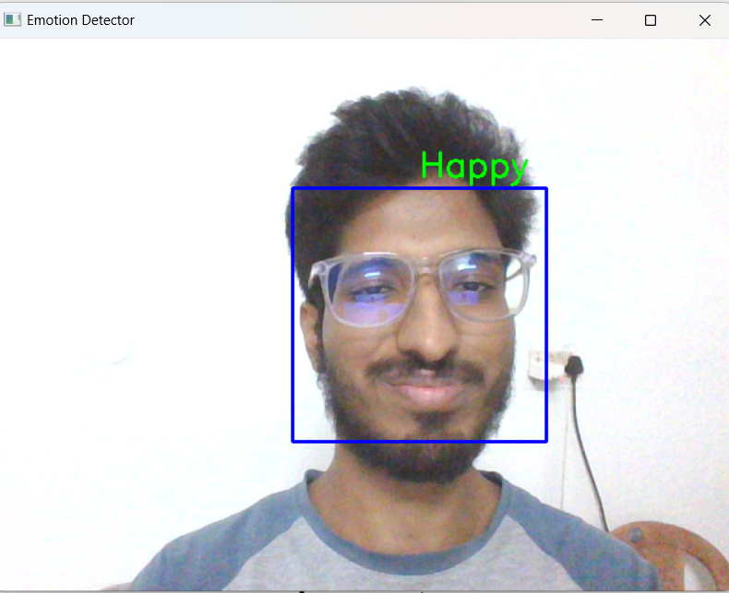
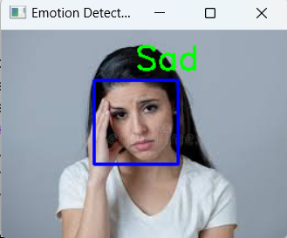
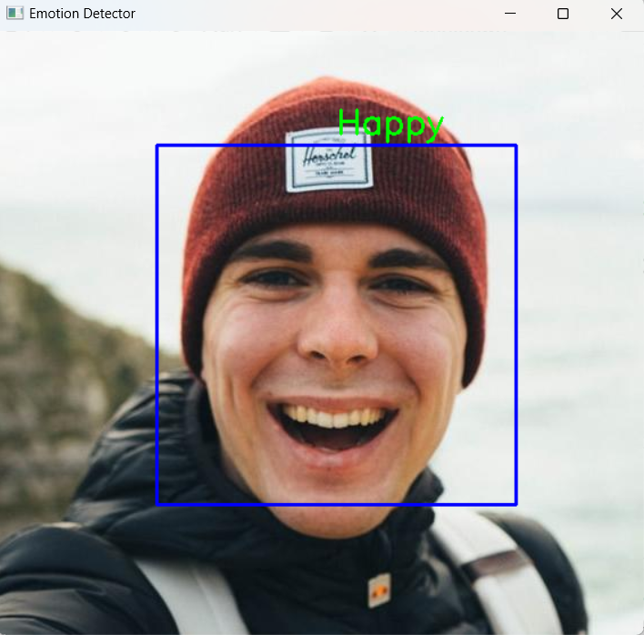
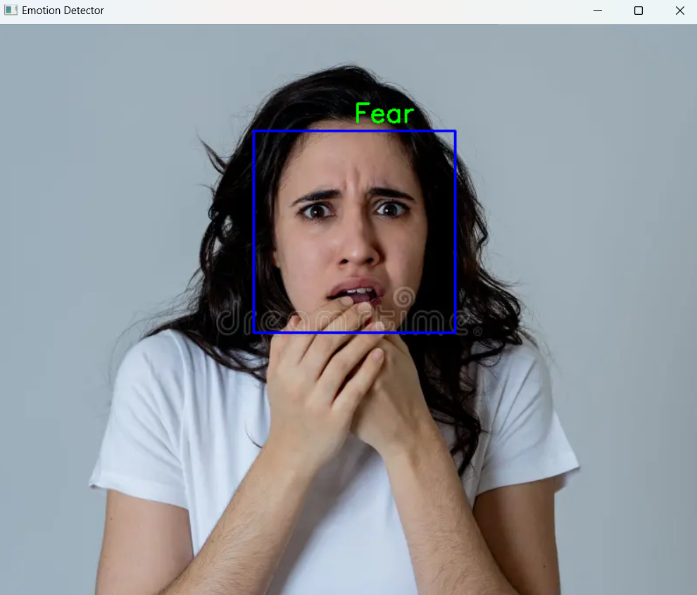
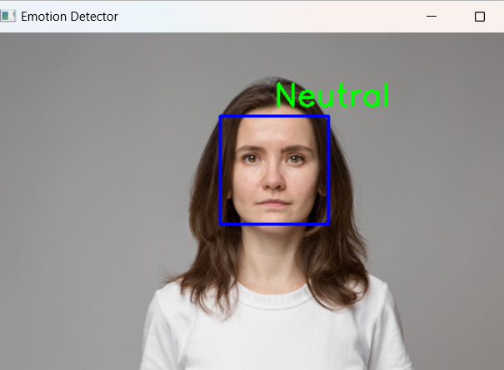
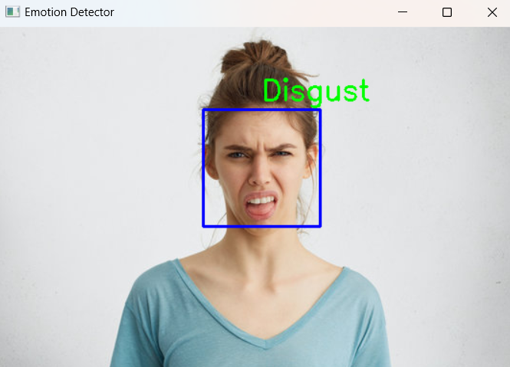
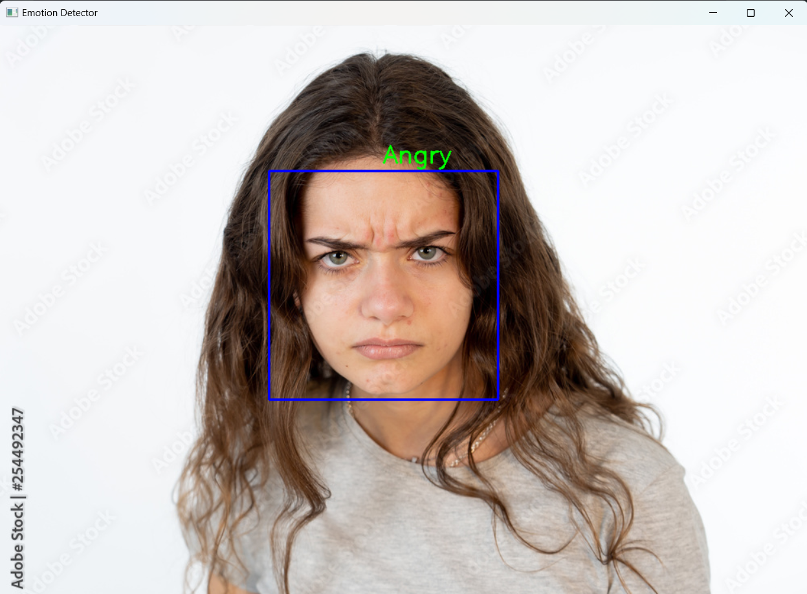
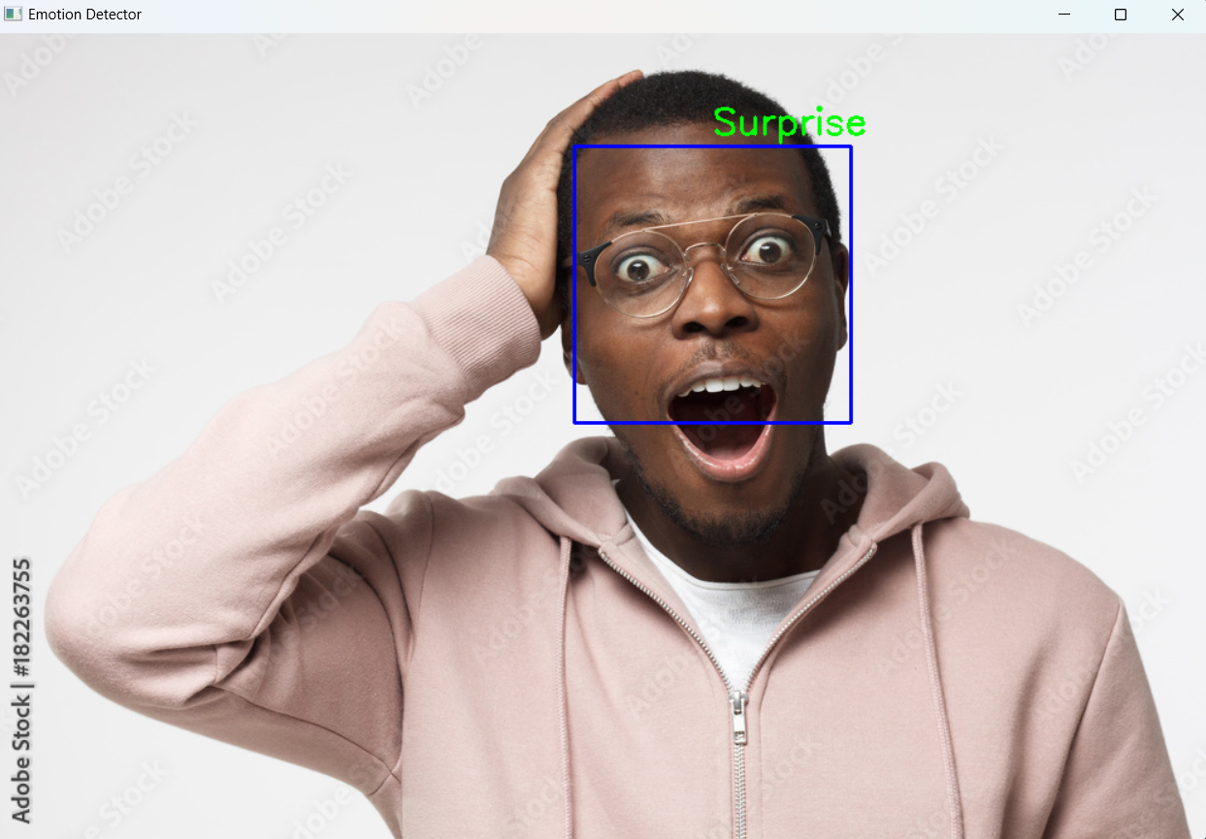
EMOTION RECOGNITION BLOCK DIAGRAM
DATA GATHERING
DATA AUGMENTATION
BUILDING THE CNN MODEL
CNN TRAINED MODEL
TRAINING THE MODEL
TAKE INPUT FROM USER
TESTING THE MODEL
IMAGE
VIDEOS
PREDICTION RESULT USING WEB CAM
RESULTS
EMOTION DETECTED

Slide 10

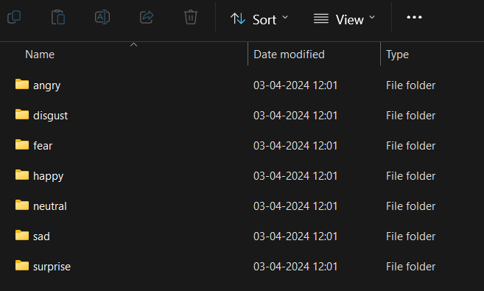
Dataset Description
Total files:35,887 images
Train files:28,821 images
Validation files:7,066 images
Angry images:4953
Disgust images:547
Fear images:5121
Happy images:8989
Neutral images:6198
Sad images:6077
Surprise images:4002
Size of datasets: 140 Mb

Slide 11







Dataset Description(Sample)
Angry
Disgust
Fear
Happy
Neutral
Sad
Surprise

Slide 12
Result and Discussion
The model was trained by using variants of above layers mentioned in model building and by varying hyperparameters. The best model was able to achieve 65% of validation accuracy.

Slide 13
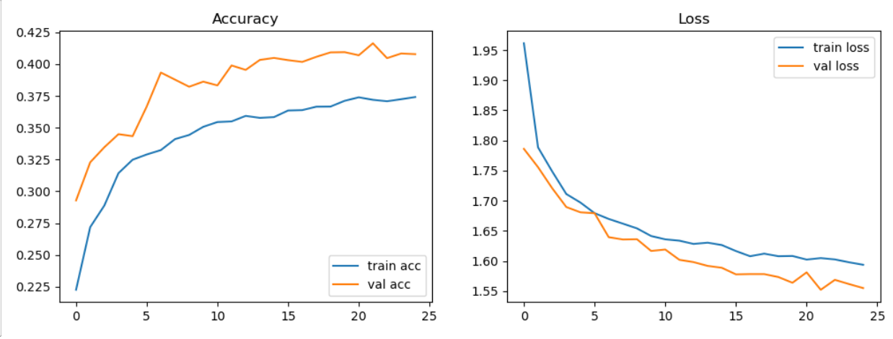
Result and Discussion

Slide 14
Result and Discussion(Images and Videos)

Slide 15
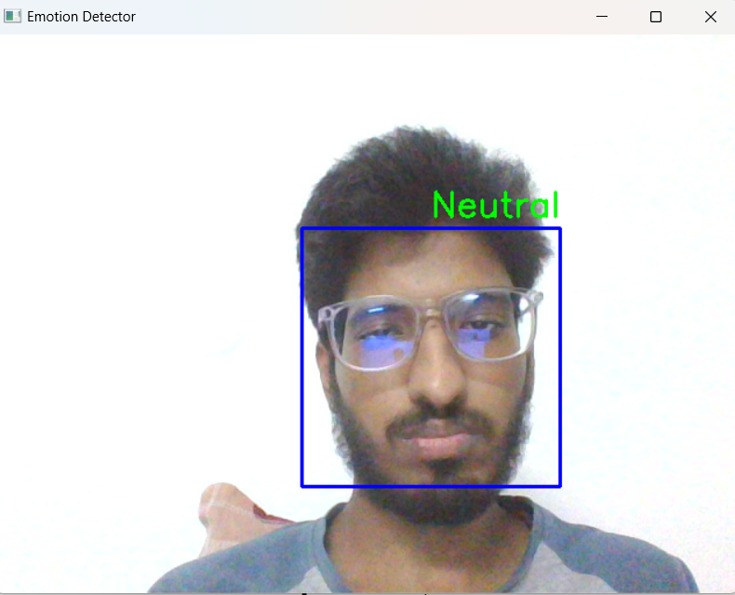
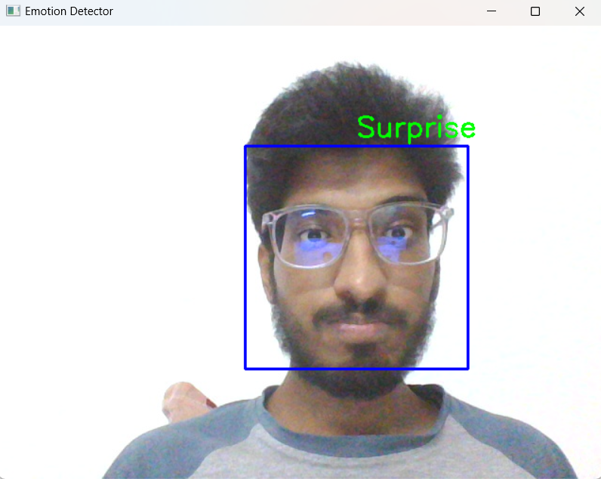
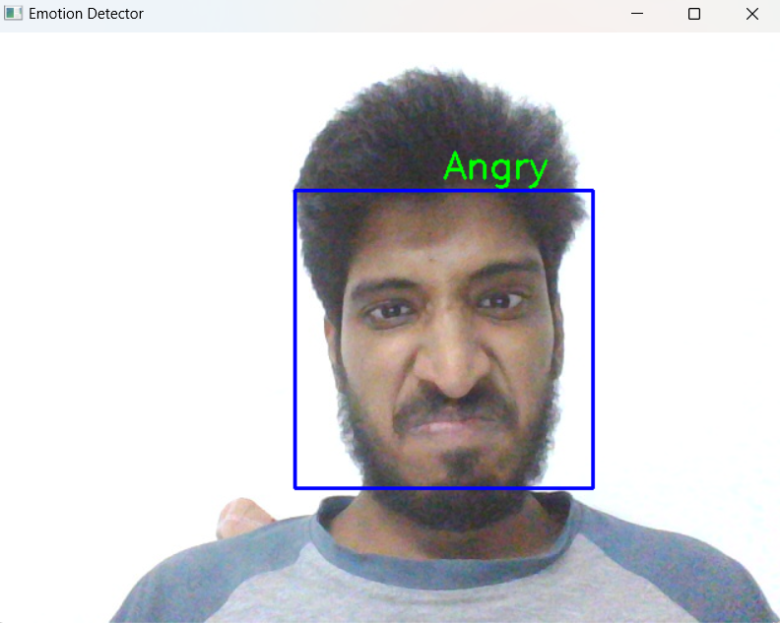
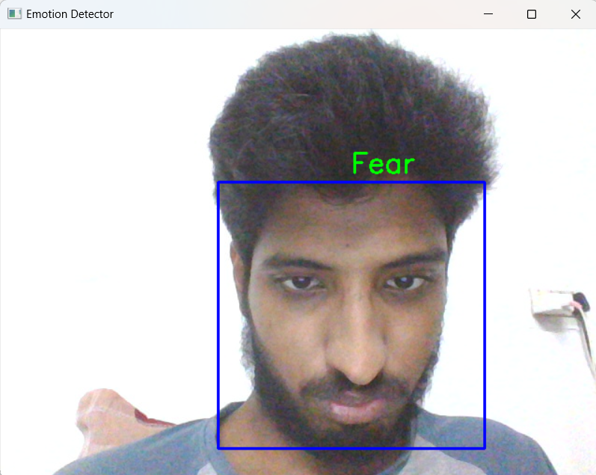
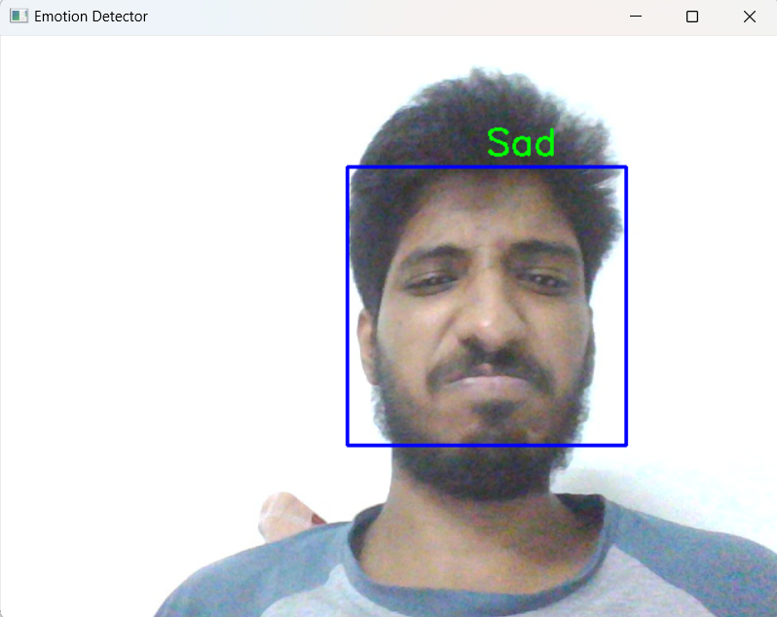
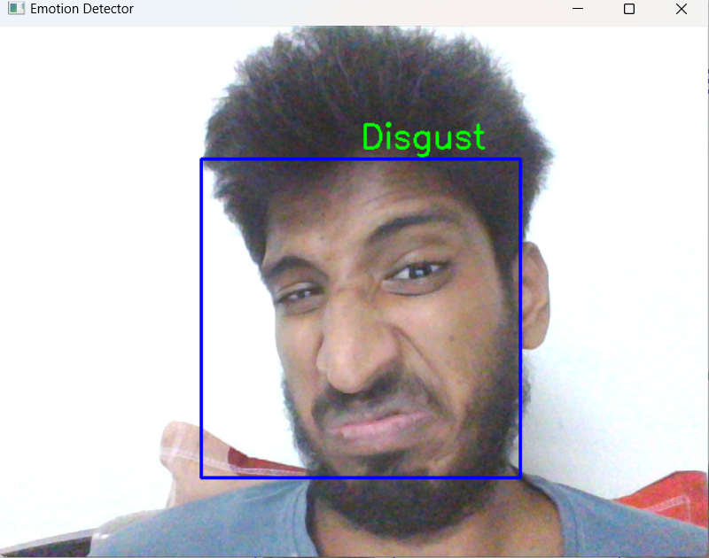
Result and Discussion(Webcam)

Slide 16




Applications in Various Industries
Business
Healthcare
Education
Robotics
Emotion detection for improved customer service and targeted marketing
Monitor patient mental health and provide personalized treatment
Enhance learning experiences and provide emotional support for students
Enable social robots to better understand and respond to human emotions

Slide 17

Ethical Considerations
Privacy concerns: Protecting user data and consent
Bias in algorithms: Ensuring fair and unbiased model predictions
Transparency and accountability: Explain model decisions to users

Slide 18

Future Trends and Developments
1
Multimodal Interaction
Combining facial recognition, voice, and body language for more natural interfaces.
2
Personalization
Customized emotion models tailored to individual users and contexts.
3
Edge Computing
Emotion AI running directly on devices for real-time, privacy-preserving analysis.

Slide 19
Thank You

